Slide 1
Dynamic Testing
Er. Bipin Thapa

Slide 2

White Box Testing
where the tester has full knowledge of the internal workings of the system
structural testing because the tester can see the internal structure of the code and test its functionality based on its internal workings.
White box testing is useful for finding defects in the code such as logic errors, boundary conditions,

Slide 3
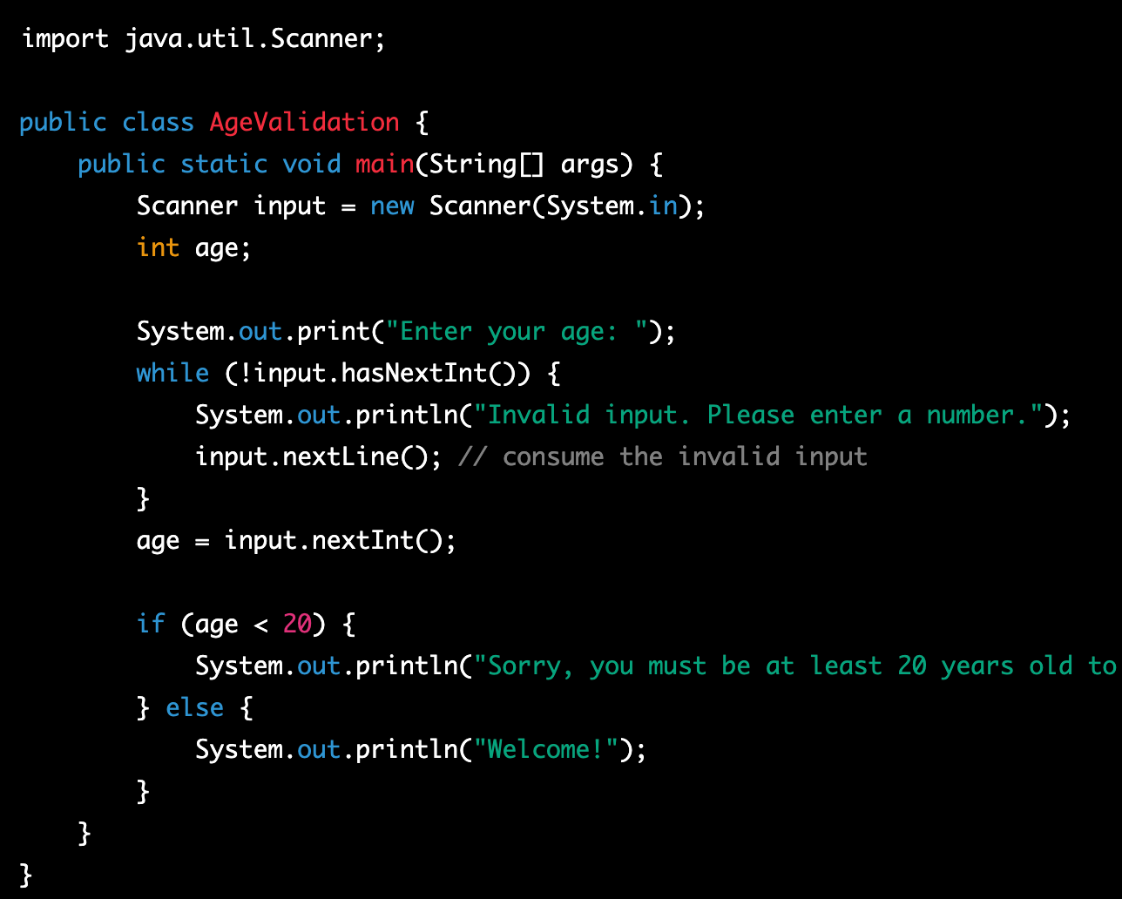

Slide 4
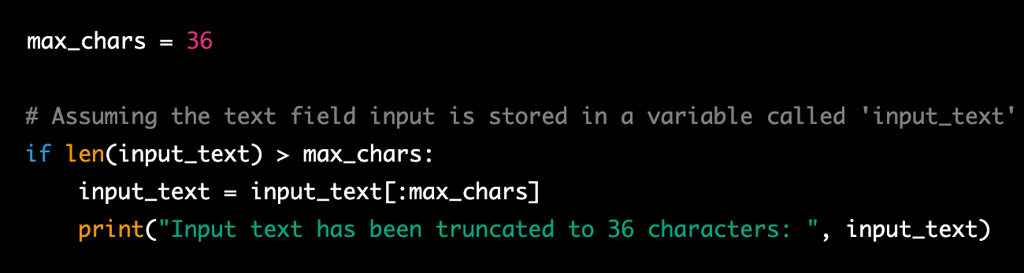

Slide 5


Slide 6
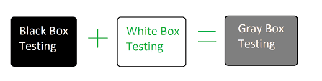
Grey Box Testing

Slide 7
White Box Testing
Statement Coverage
Branch Coverage
Path Coverage
Condition Coverage

Slide 8
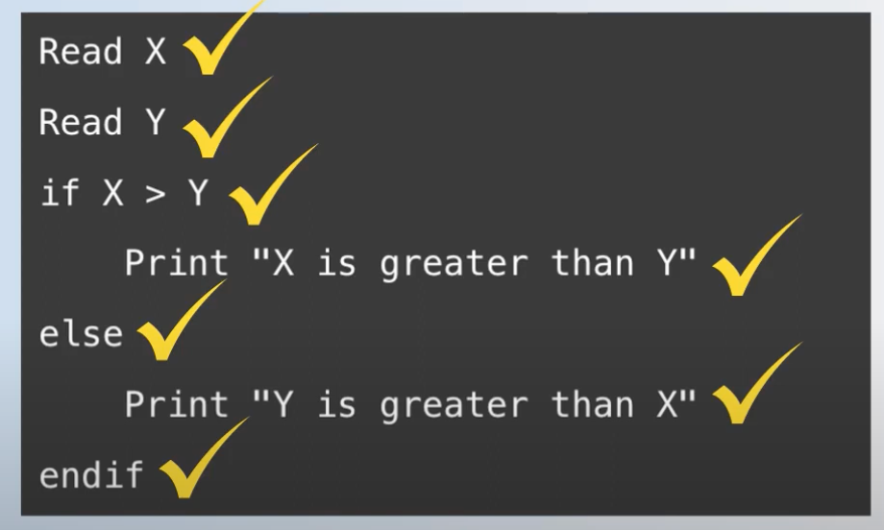
Statement coverage
All the line are covered at least once
Missing, un-used statement, un-used line of codes can be determined.
It can improved the overall Code Quality as well.

Slide 9
Statement Coverage
Formula:
Coverage: Total no. of executed during test / Total no. of executable statement.

Slide 10
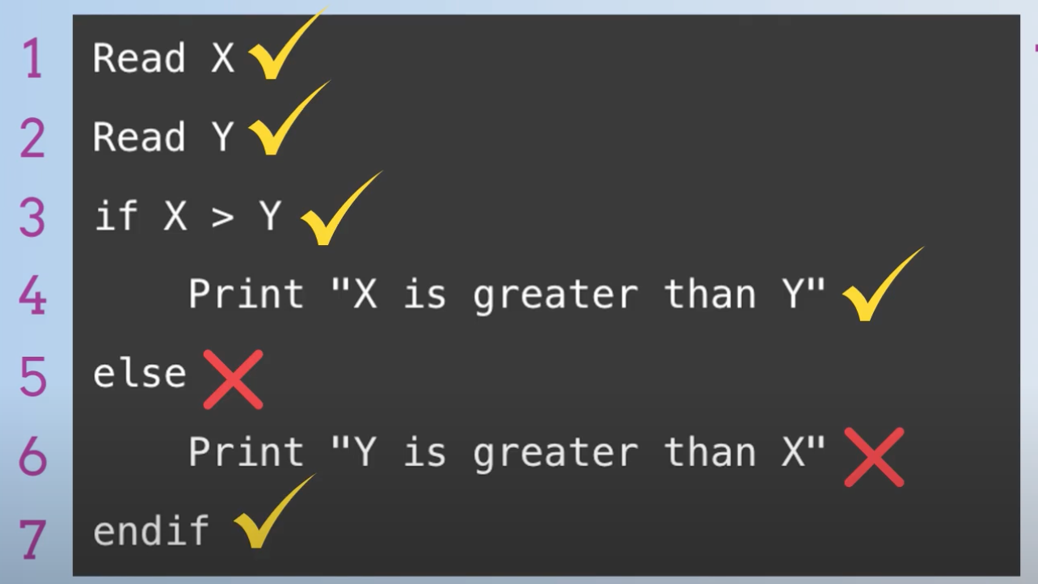
Statement coverage
Example 1: If X>Y
Coverage = 5/7
0.714*100%
71.4%

Slide 11
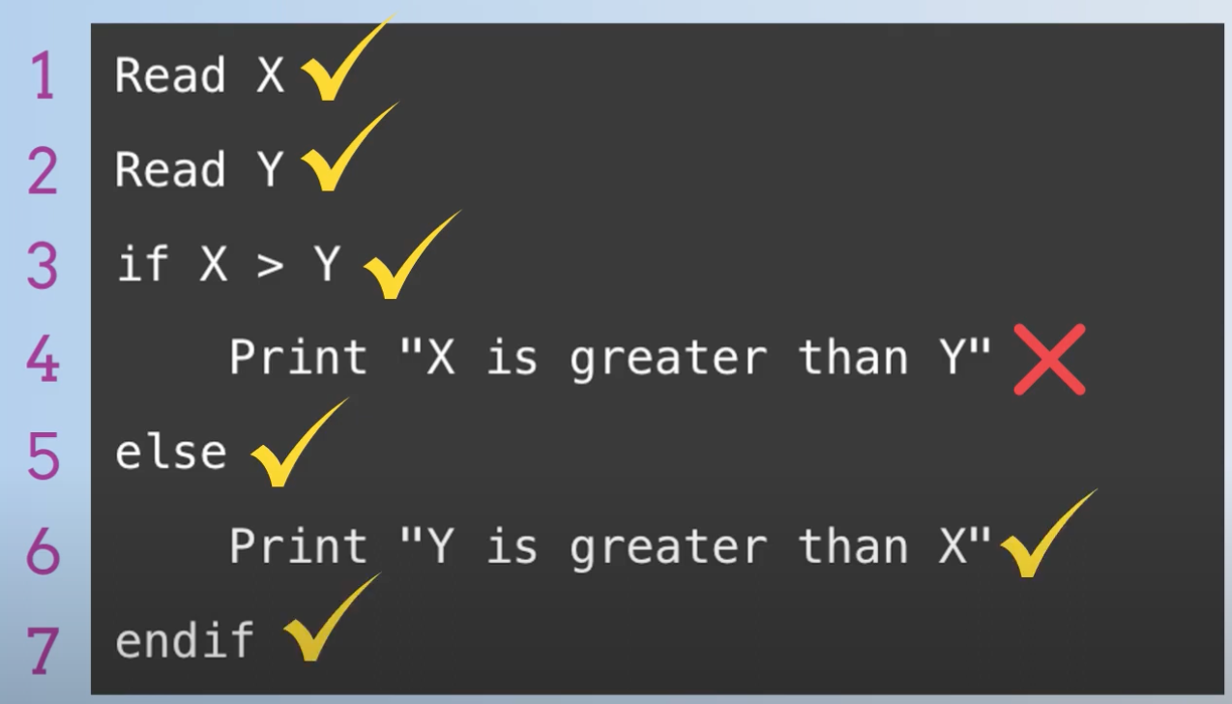
Statement coverage
Example 2: If X<Y
Coverage = 6/7
0.857*100%
85.7%

Slide 12
Branch Coverage
Branch coverage is a testing method.
Which aims to ensure that each one of the possible branch from each decision point is executed at least once and thereby ensuring that all reachable code is executed.
It helps in validating all the branches in the code making sure that no branch leads to abnormal behavior of the application.
Advantages of decision coverage:
To validate that all the branches in the code are reached
To ensure that no branches lead to any abnormality of the program’s operation

Slide 13
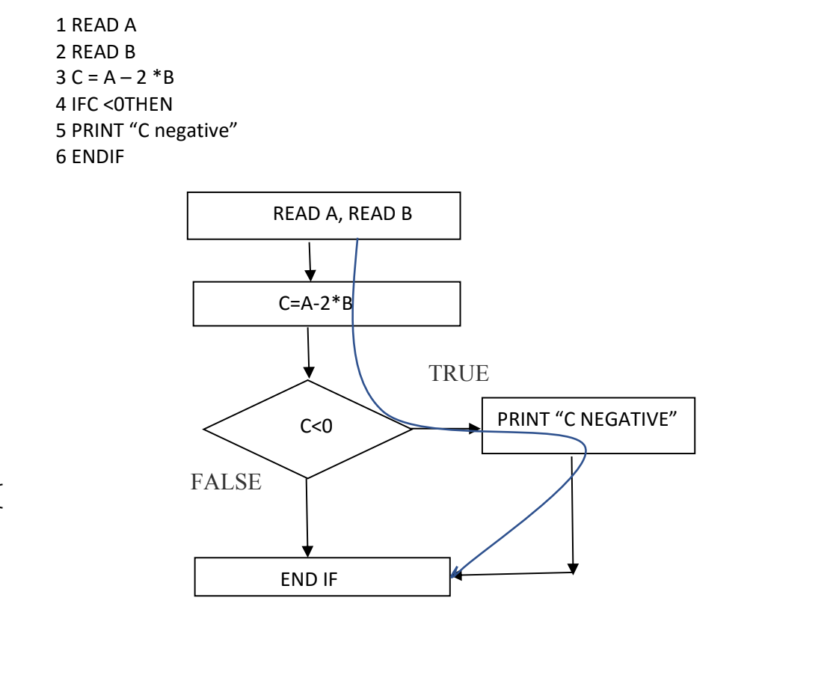
Branch Coverage
Test 1: A = 1, B = 1
Test 2: A = 3, B = 1

Slide 14
Condition Coverage
It is used to Cover all the condition while testing.
It tests all the conditional expressions in a program for all possible outcomes of the conditions.

Slide 15
Syntax:
Read a, b, c, d
if( a==0||b==0) //OR operation if any of the condition is true it will enter into the condition
{
Print 1;
}
Else
{
if(c==0 && d==0) //AND operation both condition need to be true to enter into this condition
{
Print 2;
}
}
Test 1:
a=0, b=0, c=0, d=0
25%
Test 2:
a=1, b=0, c=0, d=0
50%
Test 3:
a=1, b=1, c=1, d=0
75%
Test 4:
a=1, b=1, c=0, d=0
100%

